Slide 1

Heart disease prediction

Slide 2
Aim and Objective:
The main aim of this project is to predict whether the patient has heart disease or not based on the parameters that we receive as input.

Slide 3
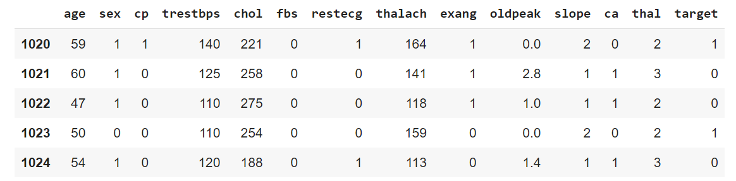
Dataset
The picture to the left is the tail of the csv file that we received as input.

Slide 4
age
sex
chest pain type (4 values)
resting blood pressure
serum cholestoral in mg/dl
fasting blood sugar > 120 mg/dl
resting electrocardiographic results (values 0,1,2)
maximum heart rate achieved
exercise induced angina
oldpeak = ST depression induced by exercise relative to rest
the slope of the peak exercise ST segment
number of major vessels (0-3) colored by flourosopy
thal: 0 = normal; 1 = fixed defect; 2 = reversable defect The names and social security numbers of the patients were recently removed from the database, replaced with dummy values.
Target : 0 = normal and 1 = Heart disease

Slide 5
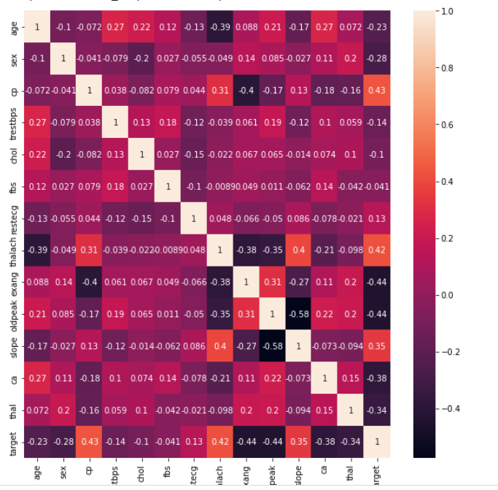
Correlation heat map
The heat map beside shows the correlation between the features.
It is observed that the cp, thalch, slope are highly positively correlated with target variable and exang, slope, ca, thal are negatively correlated with the target variable.

Slide 6
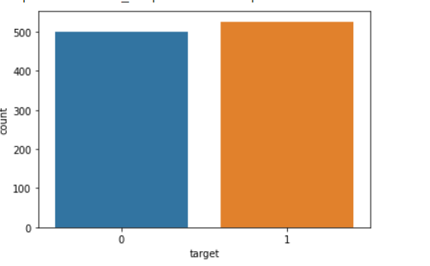
Correlation heat map
The image beside shows the count of target variables of each category.
It is observed that it doesn’t have any imbalanced dataset of target variable.

Slide 7
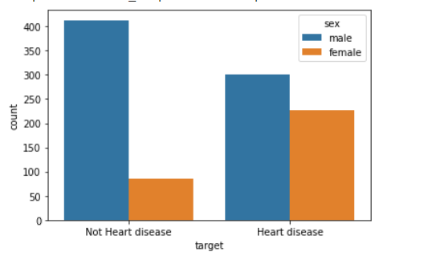
Correlation heat map
The image beside shows the count of sex column for each target variable column.
It is observed from figure that female persons are more prone to heart disease compared to male.

Slide 8
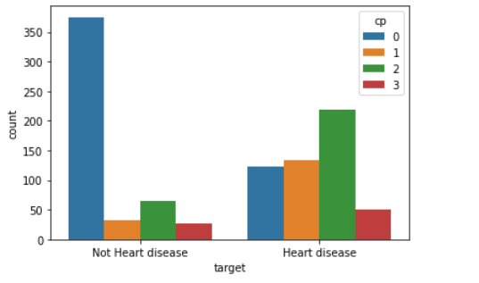
Correlation heat map
The image beside shows the count of cp column for each target variable column.
It is observed from figure that as cp value increases the risk of heart disease also increases.

Slide 9
Procedure Followed
1)After the insights were taken from EDA, I have done some pre-processing techniques like converting categorical columns to numerical columns as machine learning model accepts only numbers as input.
2) Performed the standard scaler for the input numerical columns.
3) Split the dataset to features and target column.
4) Defined the K fold cross validation with number of splits as 5.
5) Defined and trained different models

Slide 10
Models experimented
Logistic Regression
KNN
SVM
Decision Tree Classifier
Random forest classifier

Slide 11
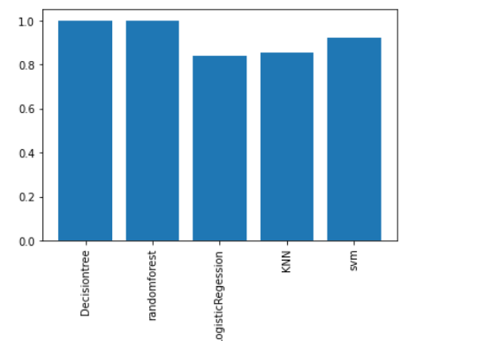
Results Obtained
The decision tree and random forest outperformed the other classification models that we have experimented.
If the data is linear, one of the SVM or Logistic regression would have performed better than other model. As decision tree has outperformed other models we can conclude that the dataset provided is of non linear in trend.

Slide 12


